Slide 1
‘Affordable’ Housing? Aye, right…….
Craig Sanderson
Edinburgh Poverty Commission
10 June 2022

Slide 2
5 Fundamental Principles
The sole purpose of a Government is to redistribute wealth.
A house is a human right, not a commodity to be traded for personal profit.
Subsidy for social housing is an investment in the whole nation's economy, health and wellbeing.
Investment in social housing keeps all prices, costs and poverty in check.
The social enterprise business model is preferable to the private business model.

Slide 3
Affordable Housing
Rents
Planning

Slide 4
Rent and 'Subsidy' Levels – 1989-2008
1989 RSLs Borrowing.
'Mixed funding' working
Cheap/long-term (30-yr) loans,
HAG rates high (up to 90%),
Rent levels kept pace with inflation.
Social Security
Commitment to Social Housing

Slide 5
Rent and 'Subsidy' Levels – 2008-2021
2007/8 Financial Crash, Credit Crunch
2009 'Firm Foundations' - Bulk Procurement
2010 HAG Competition- 40k/% RSL, 30k LA.
'You can only sell your organs once'
Austerity
2013 Welfare Reform
Grant Rates Up – 58k/% RSL
Now under 55%
Rents increasing above inflation to £87pw or more as costs increase but HAG rates flatline ie tenants increasingly subsidising new homes
Commitment to Social Housing

Slide 6
By 2020, are Social Rents Still 'Affordable'?
Measures have included:
25% of the average wage (Edinburgh Corporation, 1925)
25% of weekly wage of £3 (Manchester Corporation, 1930)
25% of disposable income (SFHA, 1990s)
25% of gross income (Various academics)
'Liveable' and '30% of income' (SRAB, 2021).
With wages, benefits and savings 'frozen' while rents increase by 2% per annum or 15% above inflation in eight years and are nearly or over £100 p.w, then......
And that's before COVID19, rampant COL, etc.

Slide 7
Housing Needs and Demand Analysis (HoNDA)
To underpin/justify each LA's Strategic Housing Investment Plan (SHIP)
Well out of date – most recent 2015.
Not good enough. Lack meaningful, localised statistics re. household incomes, rent levels, house sizes, (rising) housing costs, inadequacies of the welfare system, etc.
SG has recognised shortcomings/issued guidance for the current updates
Range of processes/scope/control eg ESESCRD- 6 LAs.

Slide 8
New Supply of Social Homes 1989-2021
1989 RSLs Developing, LAs not.
Stock Transfer
S.75
Right to Buy (½ M sold).
2010 Shelter/CIoH/SFHA call for 10k new social homes p.a.
Best Year- 7k
2016 SG Target 50k 'affordable' (inc.35k social) by 2021
' Only' 28k social completions, thanks to COVID19.
Social Housing supply shortfall gets bigger.

Slide 9
New Supply – What now?
Materials prices and Construction work stops during first lockdown
Materials prices and operatives shortages soar and new works stall
SG Publishes Housing to 2040, committing to 100k new 'affordable' homes in 10 years (later upped to 110k), 70% of which to be social.
SG then announces a cocktail of total funding (including £268m cut) and benchmark subsidy rates (average 45%) that makes this target unachievable. Maybe only half that number?
Worse, some RSLs think they'll soon not be able to build for social rent at all.
Social Housing supply shortfall gets even bigger.

Slide 10
Affordable Housing Policy
A Planning Policy, actually…..
S.75
National Planning Framework 4 (NPF4)
Consultation ongoing - 650+responses so far
Not too late to get involved!

Slide 11
NPF4 consultation- some responses
"Developers are viewed as the main customers in the planning system. Communities are left far behind. New developments to be subject to a public interest test."
Planning Democracy.
" Local authorities to lead" Scottish Land Commission
" Homes should be a recognised asset and valuable part of infrastructure. SG should give substance to an 'infrastructure-first' approach to development." BEFS

Slide 12
NPF4 consultation- my response (1)
The definition of what is 'affordable housing' is wrong.
Anything which costs the user more than social housing is increasingly unaffordable.
The best way to address both poverty and the housing crisis is to provide an adequate amount of good quality social housing for rent.
This is an investment in the present and the future for everyone and the Nation as a whole.
Processes such as the City Region Deals which lead on infrastructure development pay insufficient attention to housing in general and basically none to social housing in particular.
Given that the social housing stock is such a valuable national asset, why not treat it as infrastructure, thereby recognising its importance.
I commend the report by the Australian Housing and Research Institute which explores this concept. http://www.ahuri.edu.au/research/final-reports/309

Slide 13
NPF4 consultation- my response (2)
The planning system currently regards the private developer as its principal customer or partner. This is wrong. The process should serve the interests of local communities or wider communities of interest and should be led by local authorities (the public sector).
There is no linkage to the Scottish Government's Housing to 2040 document. This included a commitment to convert our view of housing as a commodity to create personal wealth to one which believes it to be a human right and an asset for the whole nation, both now and in future.
Housing to 2040 also commits to the delivery of 110000 new ‘affordable' homes by 2030, 70% of which will be for social rent. This is not enough to satisfy the need for social housing but must at least be a benchmark for local authorities to observe when approving planning applications.
All local authorities must establish and adhere to an 'affordable housing policy' which specifies a minimum proportion of such provision in every planning application and the amount of social housing for rent in particular. 25% is not uncommon and the City of Edinburgh Council's proposal to increase this to 35% is commendable. 70% of this must be for social housing for rent.
Social housing has a unique characteristic which differentiates itself from others - it offers security of tenure.

Slide 14
NPF4 – definition of 'affordable' housing
" Of a reasonable quality that is affordable to people on low incomes. This can include social rented, mid-market rented, shared ownership, shared equity, housing sold at discount, self-build plots and low-cost housing without subsidy. "

Slide 15
Edinburgh’s Housing Crisis
Shortages of all tenures
High house prices
AirBnB
Highest PRS rents (average £1200, £5k possible)
High Council and RSL Rents
Decades-long underinvestment by Westminster/Scottish Governments (£74m p.a.?)

Slide 16
Edinburgh Poverty Commission
Edinburgh Partnership, inc. City of Edinburgh Council (CEC)
12 independent people
18 months, 500+ hours LISTENING
Final Report September 2020
All recommendations accepted apart from:
CEC/RSLs to build 2000 homes for social rent
every year.
705 (2019/20), 252 during 2020/21.......

Slide 17
Edinburgh Social Rent Supply Stalls
Target of 20000 new affordable homes in 10 years to be met at all costs
Focus on Build to Rent and student housing.
Mid-market rent acceptable/affordable because it costs less than the PRS
RSLs losing the will to fight
Developers manipulating the planning policy/system

Slide 18
Planning Applications - Edinburgh
21 Applications 2020/21, all meant to include an Affordable Housing Statement.
All social rent – 1
25% affordable, all social rent - 3
25% affordable, all MMR - 4
25% affordable, 30% social - 1
25% affordable, 75% social - 1
All affordable, 75% social rent – 1
All affordable, 50% social - 1
No affordable – 3
No Affordable Housing Statement - 6

Slide 19
How much Social? CEC (and Developer) response
" Local Development Plan (LDP) policy is for 25% of the units to be affordable housing.
In terms of .... how many are for social rent then that is negotiated with our affordable housing colleagues, the developer and any affordable housing provider (an RSL).
At this stage it is too early to say."

Slide 20
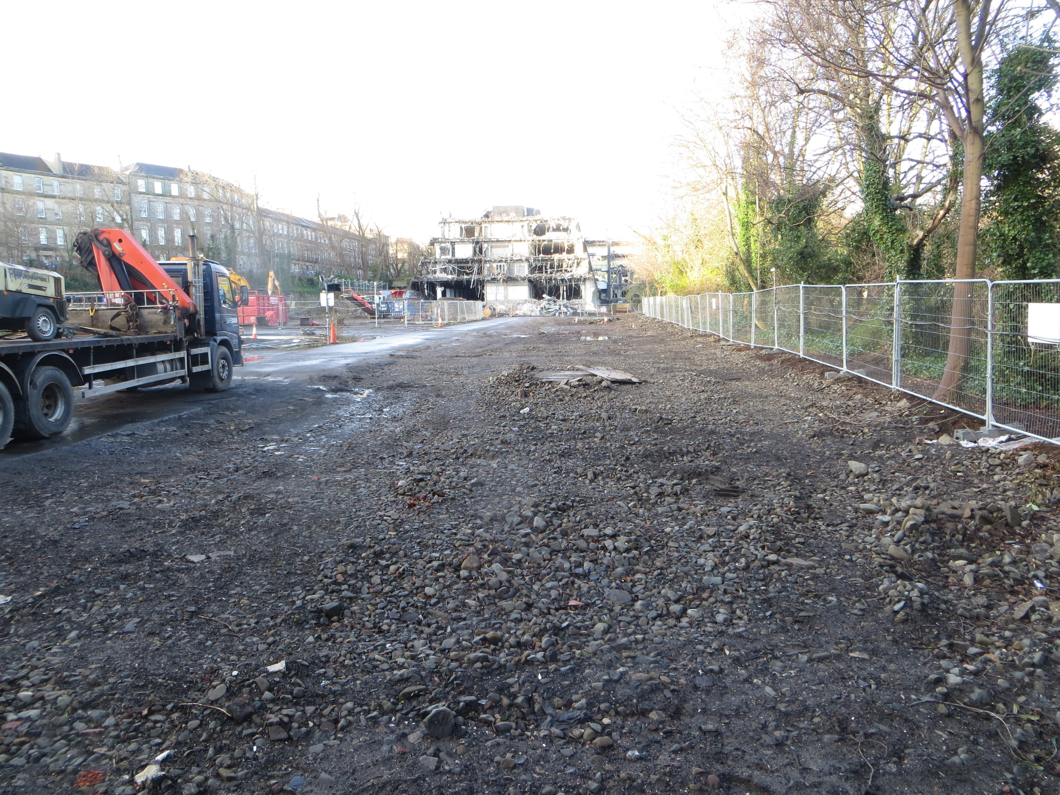
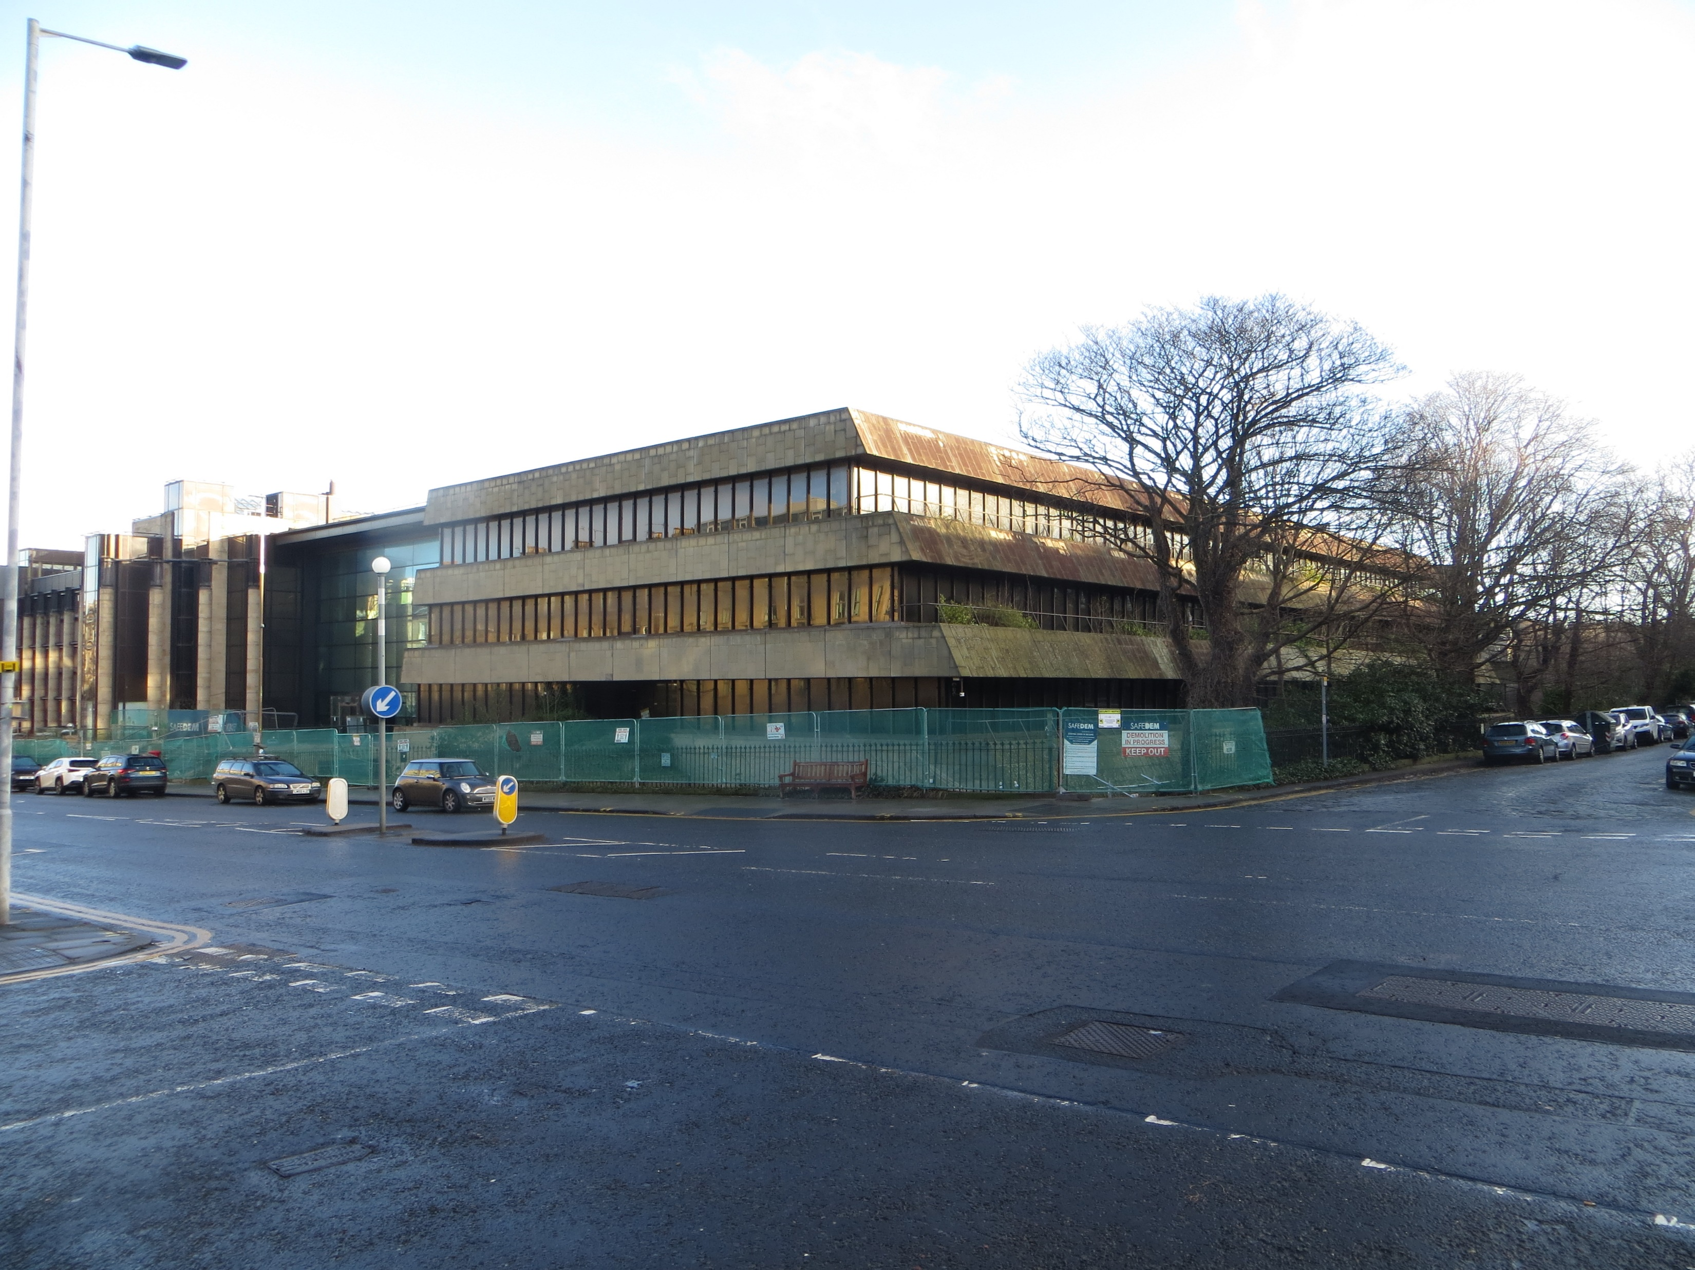
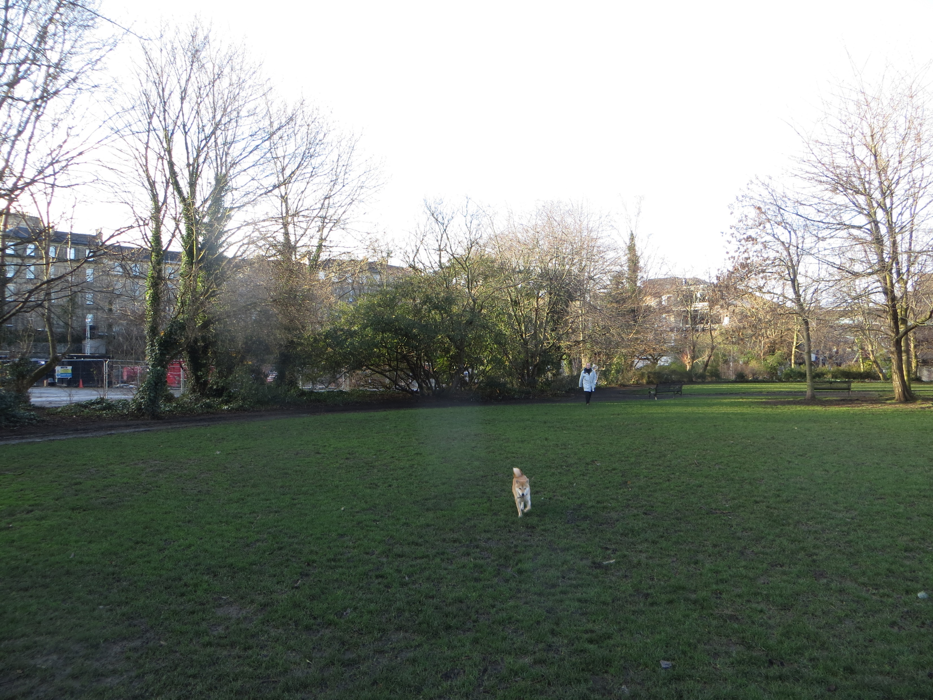
Royal Bank Offices

Slide 21
Terminological Inexactitude
" Rents will be capped based on Broad Rental Market Area (BRMA) 30th percentile. The Council have (sic) confirmed that the average household income in the city is £44,000 per year. Rents at the BRMA 30th percentile are considered to be affordable to those earning below the average income."
The MEDIAN income of a tenant in Edinburgh is £19k
A senior care worker earns £21k.
The 'BRMA 30th' rent is £184 per week
Local Housing Allowance (LHA) cap is £154 per week.
Affordable? Aye right....

Slide 22
The Big Issues
Increase investment in SOCIAL housing
Use correct terminology, don't 'spin'
Re-finance housing to peg (or even reduce) rent levels
Other funding - PWLB(half council/RSL rates?), council pension funds
Reform social security
Reform taxation – Council, land, income and wealth tax.
Pilot and establish Universal Basic/Citizens' Income
Demonstrate added social/economic/environmental value
Establish faith in an honest, transparent commissioning and procurement system for delivering quality public services.
Pay attention! Question, challenge, monitor and evaluate incessantly
Get your 'lived experience' message across to SG

Slide 23
Other Reports
Affordable Housing :The SG's Affordable Housing Supply Targets. (Accounts Commission, March 2020)
The Value, Incidence and Impact of Developer Contributions in Scotland, (SG , July 2021)
Affordable Housing Need in Scotland Post-2021 (CIoHS, SFHA, ShelterS, May 2020)
The 'Benny Higgins' Report (summer 2020)
HARSAG (summer 2020)
If Not Now, When? (Social Renewal Advisory Board, January 2021)
The Impact of Social Housing: Economic, Social, Health and Wellbeing (CACHE, September 2020)
A Scotland of Better Places (David Hume Institute/Duncan McLennan, June 2021)

