Slide 1
Navigating Climate Change
– Wheatley Group
Jehan Weerasinghe
Managing Director, Wheatley Homes Glasgow
June 2022

Slide 2
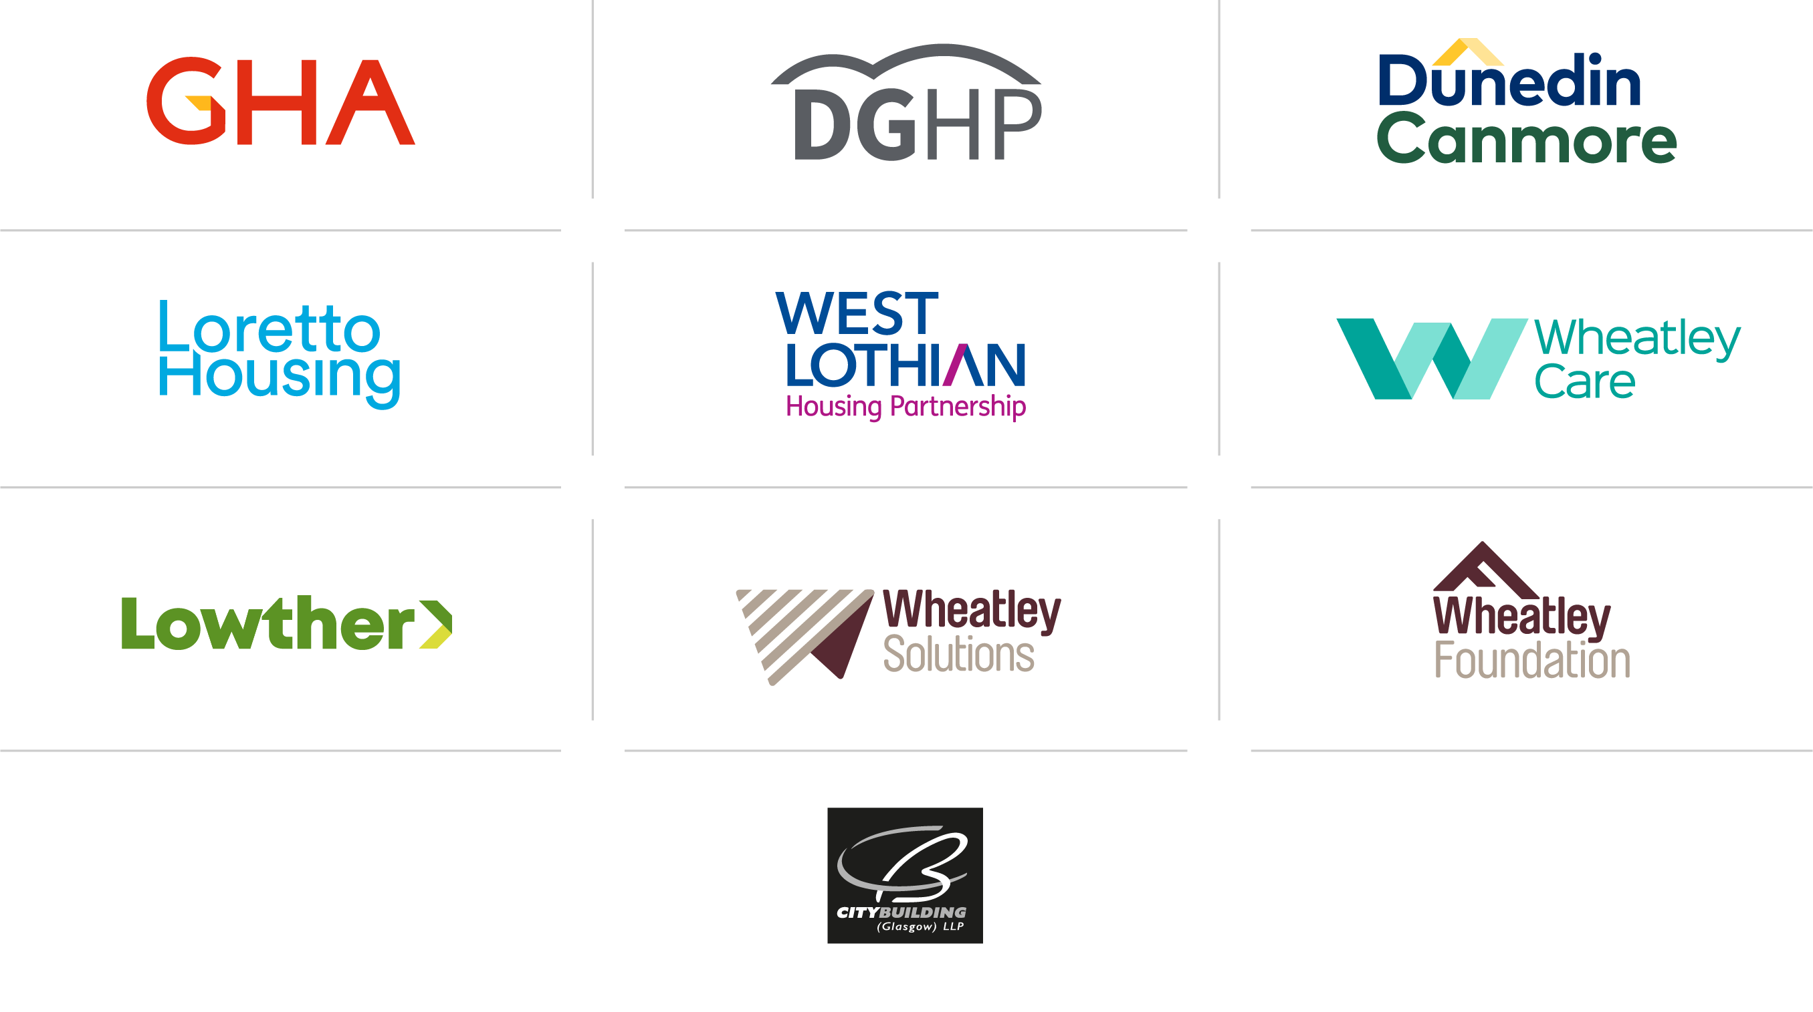

Our partner organisations

Slide 3



Wheatley Group
Wheatley is Scotland’s leading housing, care and property-management group and one of the UK’s best-accredited organisations.
Owning or managing over 93,700 homes, Wheatley delivers award-winning services to over 210,000 people across 19 local authorities.
Wheatley employs 2,700 people directly and a further 2,000 as joint owners of one of Scotland’s largest repairs and maintenance companies, City Building (Glasgow).

Slide 4
Our strategic ambition
Setting the Benchmark for Sustainability and Reducing Carbon Footprint
Reduce CO2 from our homes by at least 4,000 tonnes per year
Low and zero carbon energy technology = at least 15,000 homes
Carbon neutral corporate footprint by 2026
Notes:
Strategic objectives and what the drive
Reduce the output of Co2 from our homes/innovation –low zero carbon
Currently emit about 200,000 tonnes of CO2 from our properties each year
Co2 has been and will be reduced through our investment work – currently estimate 47kg/m2 from our properties crf sector average of 78kg/m2 – Reducing carbon meets our strategic target and moves us towards EESSH 2
Journey to EESSH2
First step – base line existing stock we have a lot of stock low C/high D. Knowing this allows us develop detailed plans for EESSH 2 on a property by property basis.
Looking at distance to travel to B – EESSH2 estimate
Focusing on distance to travel
6% of stock within 5 points of ‘B’
43% between 6 and 10 points
39% between 11 and 15 points
1% More than 15 points
As a guide expect the following uplift form investment in our plans
Connected response – 8 Points
New /upgraded windows – 3 Points
Solar panels - 11 Points
Solar panel plus battery storage using Tesla batter wall like we are trying on DGHP - 22 Points
Bespoke investment plans being developed for each property, in doing this – need to be aware of evolving technology – do not want to go with solution that becomes obsolete. Key focus will be fabric first although we have invested significantly in the fabric of our stock – GHA investment programme and as new partners joined group. Ongoing programme in DGHP of Fabric improvements – EWI and windows. Decarbonising heating will make major contribution although still emerging technology and still need to see government proposals – expected in December – on use of hydrogen. Implications for existing boilers (short-term as some hydrogen is added) and gas distribution network of pumping hydrogen, longer term). Electric heating will also feature – using renewable energy – although requires significant investment in electricity distribution network
Decarbonising corporate estate
Wheatley House previously:
Carbon Footprint of 388 tonnes per year (nearly 1 tonne per employee based there) assessed by Planet Mark .
Mostly related to power and transport
EPC rating of ‘D’
Refurbishment:
Designed with heat recovery ventilation systems with power from solar PV and 2 electric batteries
Cycle storage to promote active travel
Enhanced air quality, lighting and internal environmental
Estimated 160 tonnes (41%) reduction in 1st year due to removal of fossil fuel use and other improvements.
Wider business model
Home working can reduce emissions by 70% ( source; UK Energy Research Centre) – 50kg a day saving by working at home..
Increasing use of electric vehicles, active travel options, electric bikes and more.
Increased use of onsite renewable generation and storage as part of new office and corporate estate.
Powering (heat and light) the building account sfor 90% of CO2
Last year estimated CO2 (again through Planet Mark) was 223 tonne (pre refurbishment) reflecting pandemic and the building not being used.
Refurbishment and blended working model expected to make further significant inroads into C02 emission. In addition, changing to 100% green energy will further reduce of CO2
Design of building also focused on sustainability – upcycling furniture, locally sourced where possible, recycling, planning to install EV charging, refurbishing lights to work with LEDs. Increased planting and materials used – low or no VOC (volatile organic compounds), all about ensuring good air quality

Slide 5

Energy performance of our stock
Group wide position calculated based on available energy performance ratings for our stock, uplifted for investment made since energy performance was assessed
Stock Challenges:
  1980’s tenemental based ‘Community Renewal’ – EWI
  Pre-1919 sandstone tenements – listed buildings + expensive per unit to improve
  MSF – Connected Response gets most to a high ‘C’. Led lighting, extra draught proofing and triple glazing provide options to get to ‘B’
8,767 (13.9%)
47,933 (76.0%)
6,380 (10.1%)

Slide 6
Investment in low carbon infrastructure and energy efficiency
200
Battery storage devices in 200 homes by 2022
4,000
Scotland’s largest network of district heating connections – over 4,000 low or zero emission connections
£1bn
Over £1 billion in improving stock with
a significant focus on EWI
1,000
Over 1,000 Connected Response systems installed
800
Over 800 properties with solar generation
1,300
Air Source Heat
Pumps already installed
Notes:
Over £1 billion invested in improving GHA stock with major focus
on EWI
£13 million invested in improving energy performance of DGHP this year, with £27 million planned over the next five years
Over 8,000 tonnes of CO2 reduced because of investment in 2021/22
Planned investment in energy efficiency and net zero over next two years: £22m incl VAT. Examples include:
Air source heat pumps
Connected response installs & materials
Energy efficient windows and doors
EWI
EESSH2 – specific projects.
1,300 Air Source Heat Pumps already installed
Over 800 properties with solar generation
£5.6M investment in 10,000 electric heating controls reducing energy waste and cost
£1.5M investment in battery storage devices in 200 homes by 2022
Scotland’s largest network of district heating connections and continues to grow
Continuing investment in ‘fabric first’ to reduce overall energy requirement
6,500 tonnes of carbon reduction this year.

Slide 7
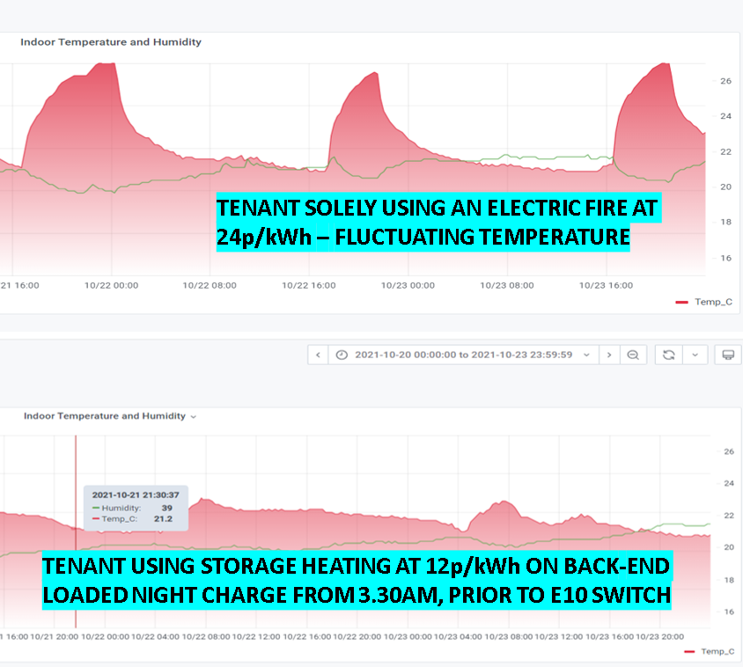
Connected Response
20% reduction in energy use
Improved comfort and control
Temperature and humidity
Overall reduction in cost & carbon
NIA – OFGEM – Constrained wind tariffs (Utilita and Scottish Power)
Carbon Reduction of network and heating systems + reduced energy consumption
1/3

Slide 8
Customer Impact –Cost of Living
1st April Estimate Impact on customers
  standard tariffs pay an average of £693 more per year
  prepayment customers will see an average increase of £708
Team of Fuel Advisors –advising customers through array of emerging fund
Energy Crisis Fund £2m (part funded by Ofgem)
EatWell
Foundation activity informed by crisis

Slide 9
Scottish / UK Wide Funds
Scottish Power and SSE hardship funds
UK Gov -Warm Home Discount Scheme one of discount £140
UK Gov -£200 discount (paid back over five years in £40 instalments
Scot Gov -£280m to provide £150 Council Tax reduction (Band A-D)
Scot Gov -£10m fuel insecurity fund
Proposal to replace Cold Weather Payment for 2022 -Low Income Winter Heating Assistance -400,000 households payment of £50

Slide 10
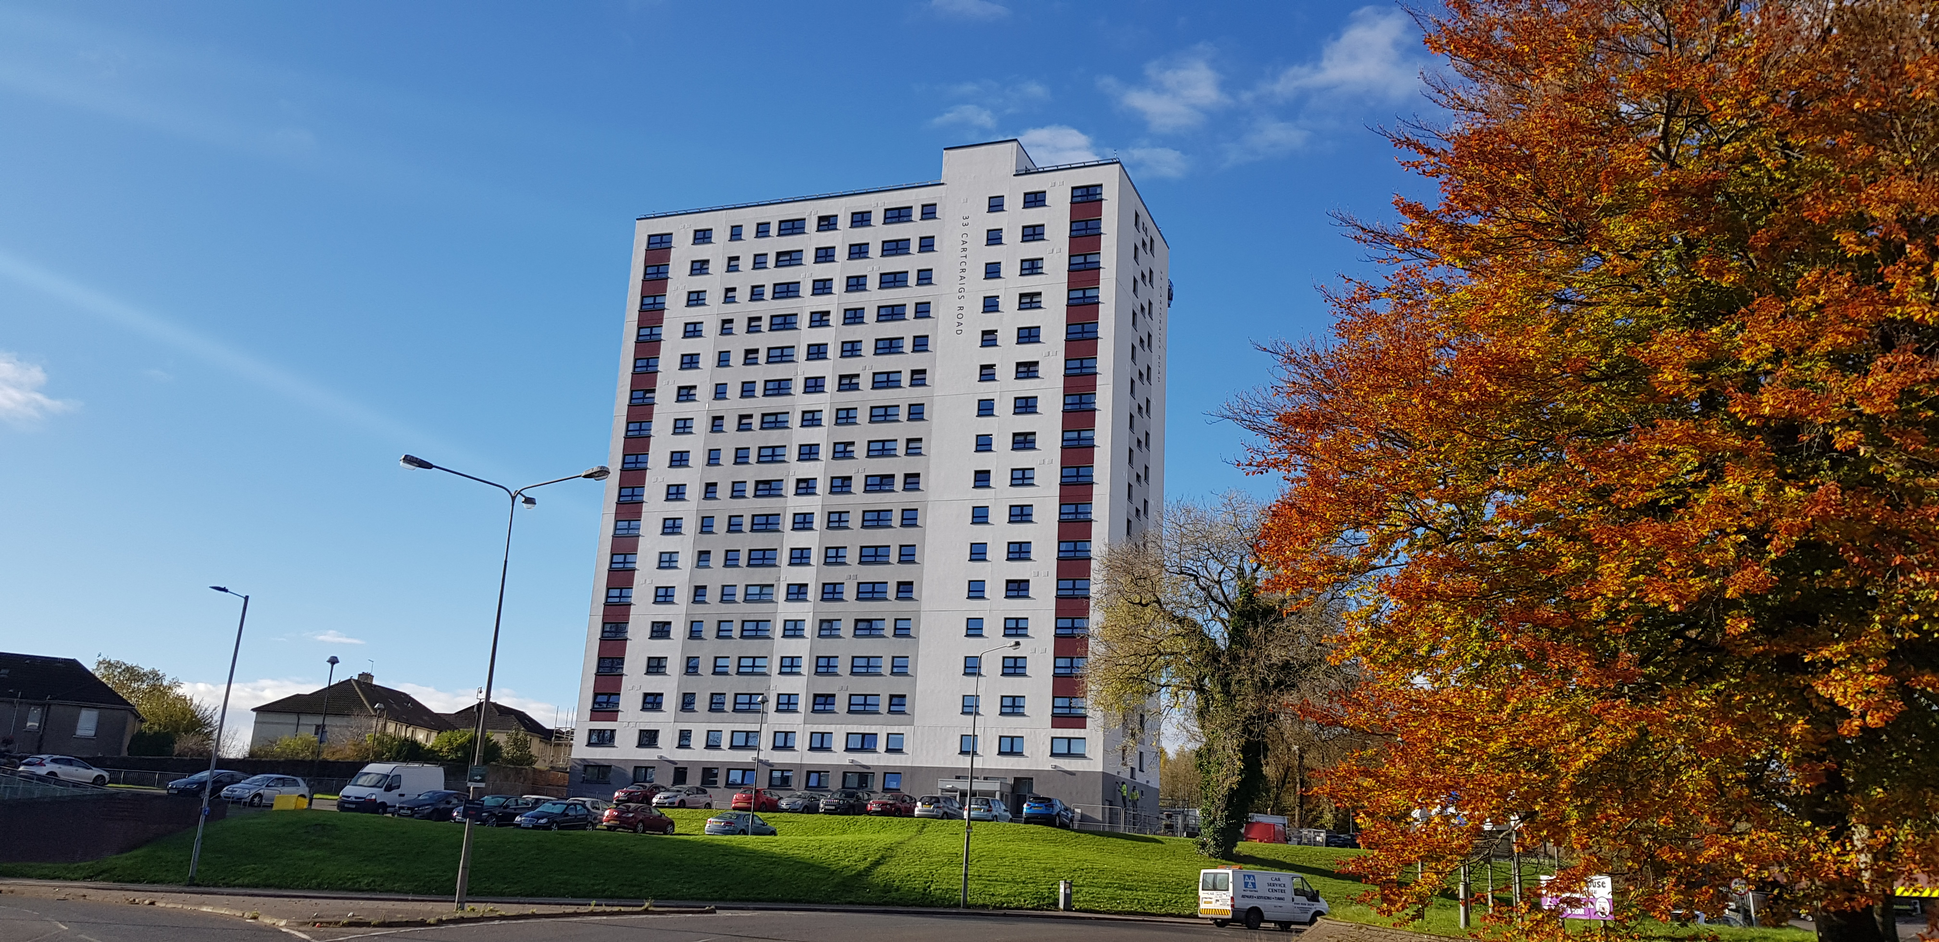
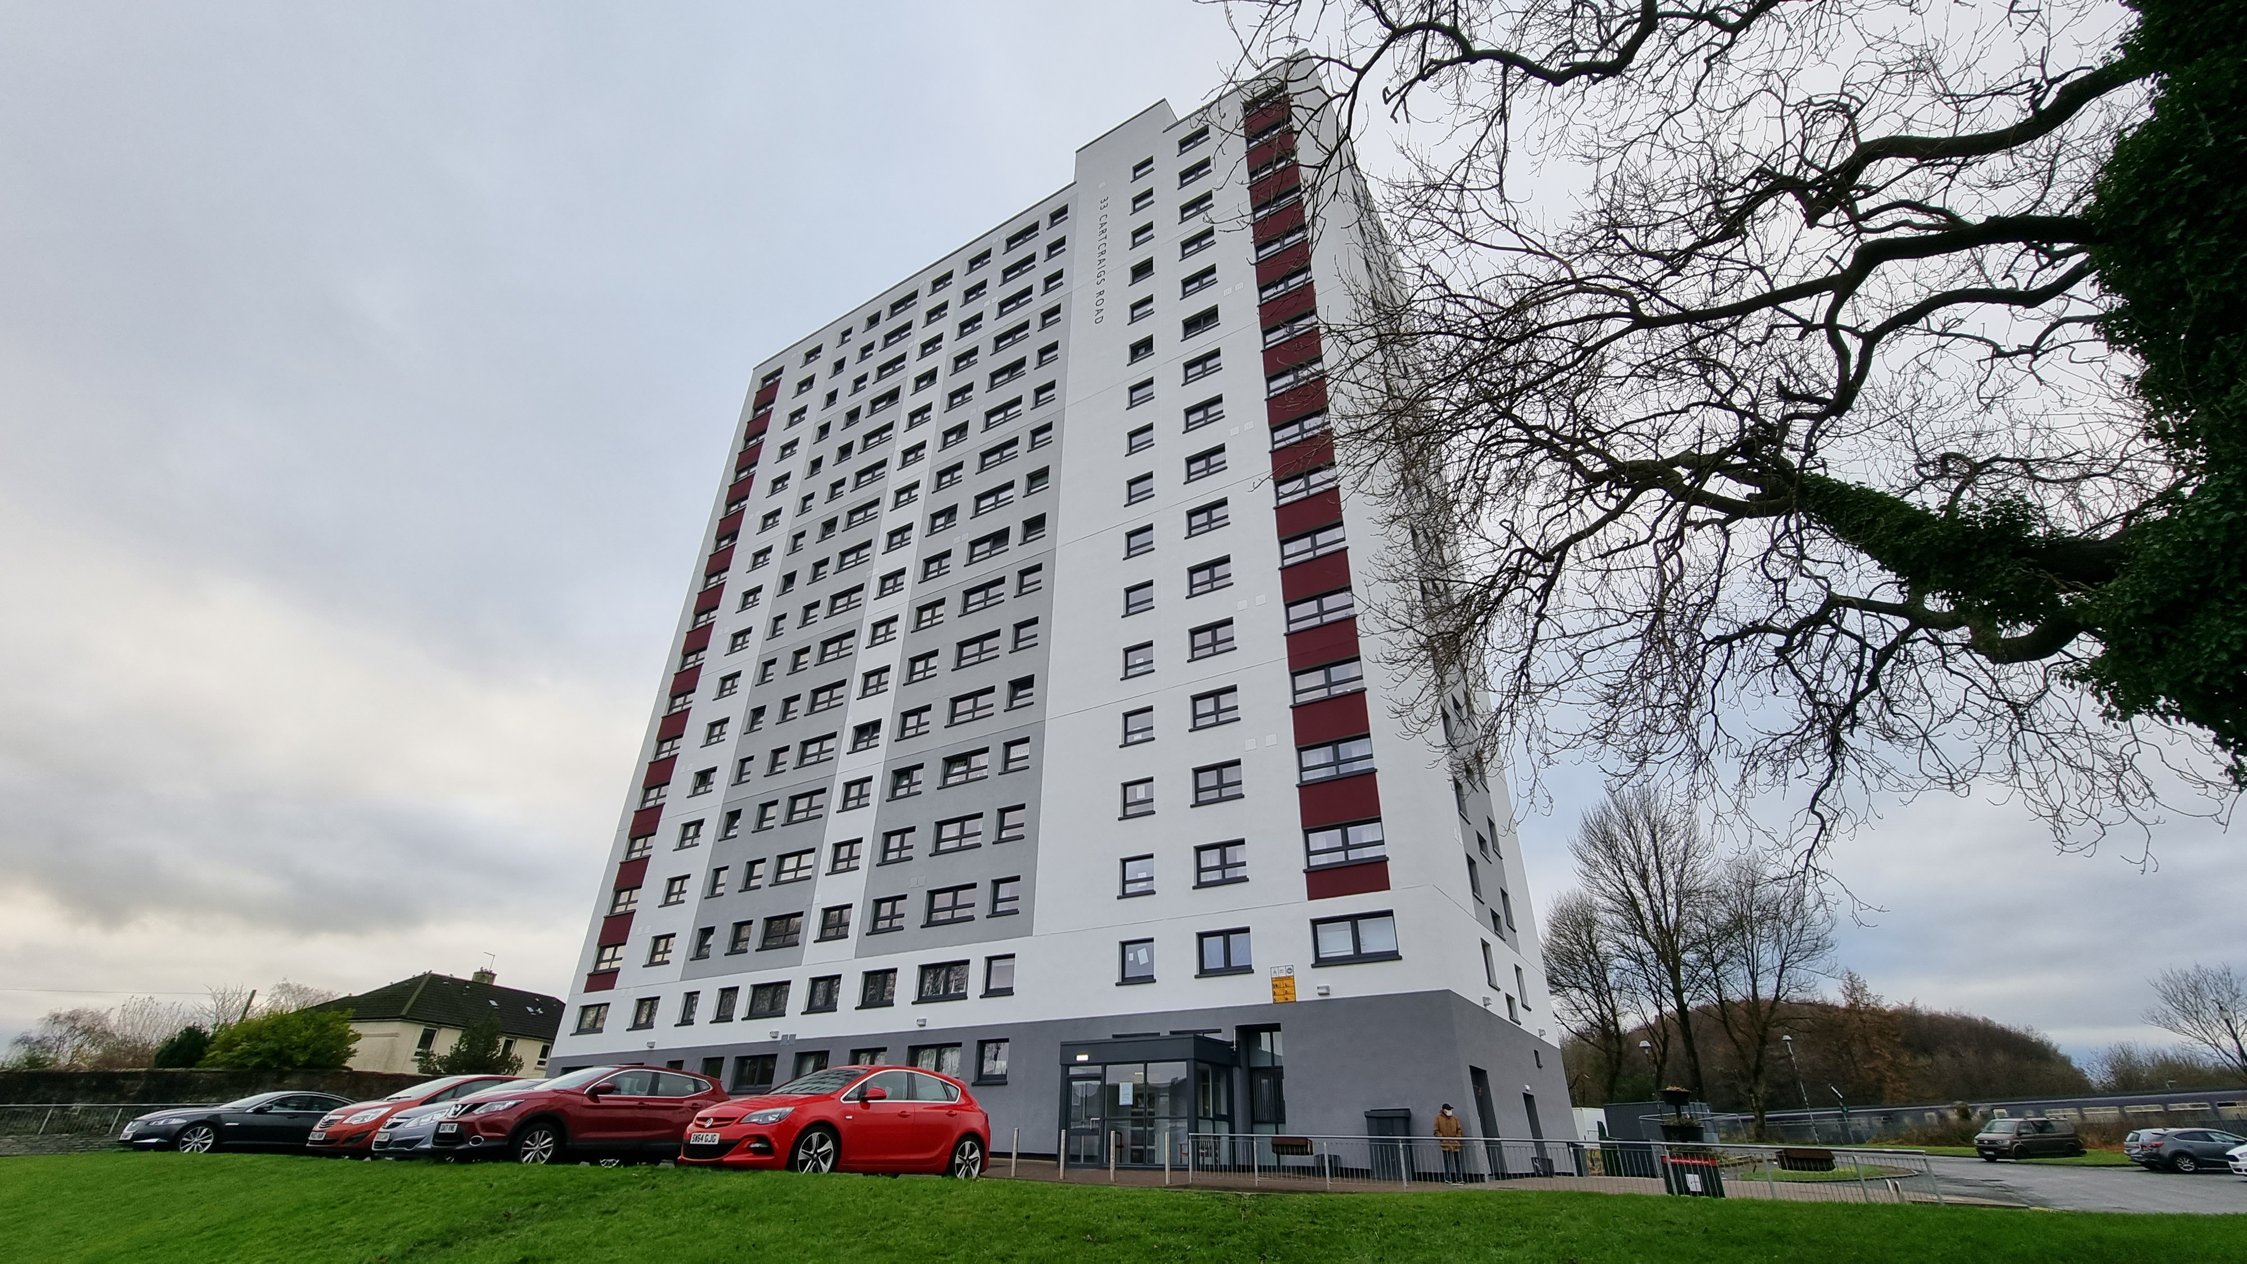
Example of typical investment on EWI
£2.6m fabric first upgrade of high rise building (33 Cartcraigs Rd)
134 Wheatley Homes
Completed November 2021
160mm Rockwool Insulation and highly efficient windows
Fabric improvements further supplemented by installation of Connected Response smart technology
Post improvement equivalence of EPC Band B

Slide 11
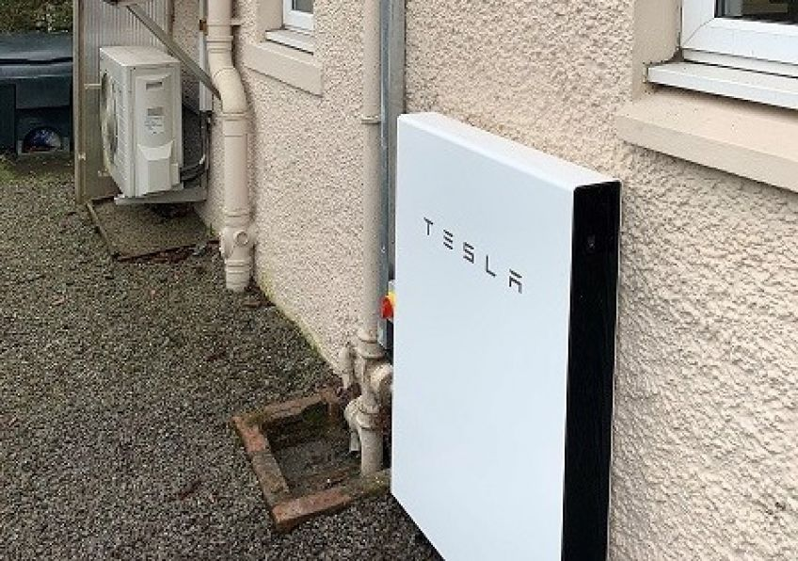

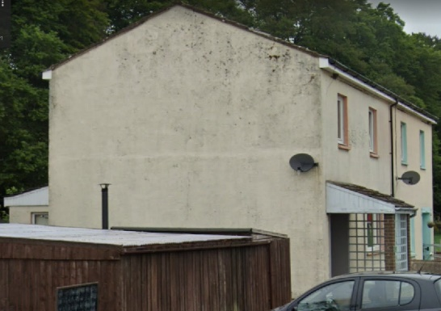
Net Zero housing
DGHP SHNZ funded
Focussing on ‘house type’
Over 1,000 dwellings
  EWI
  ASHP
  Connected Response
  Solar PV
  Battery storage

Slide 12
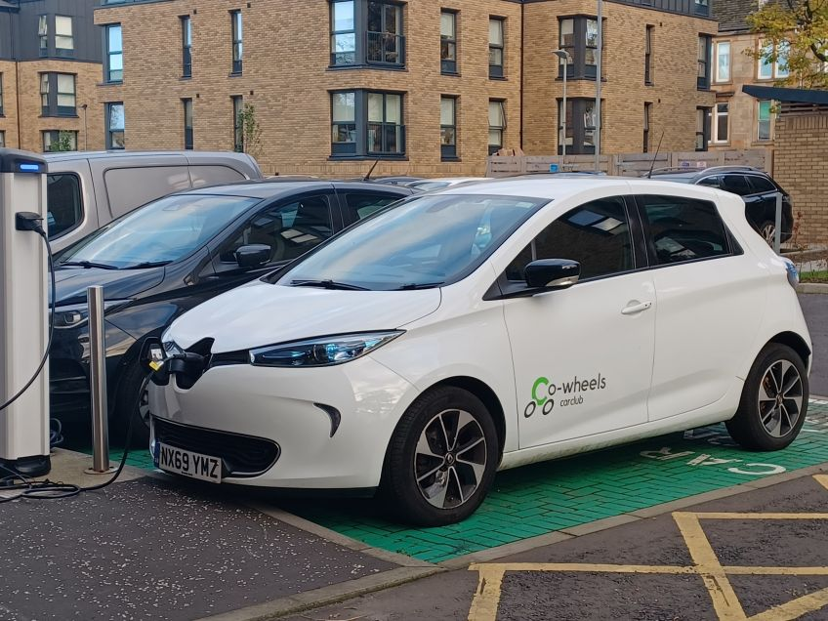
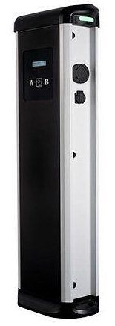
Decarbonising our business
Planet mark – assessment of main contributors:
  Heating our buildings
  Fleet
  Travel to work.
Upcoming Actions
  Fleet electrification review
  100% renewable electricity procurement
  Electric charge point infrastructure
  Replace petrol power tools with electric, where spec meets need
  Active travel – linked to remobilisation
  Sustainable procurement strategy.
Track record in reducing emissions
  Cycling infrastructure
  Trees and green space.

Slide 13
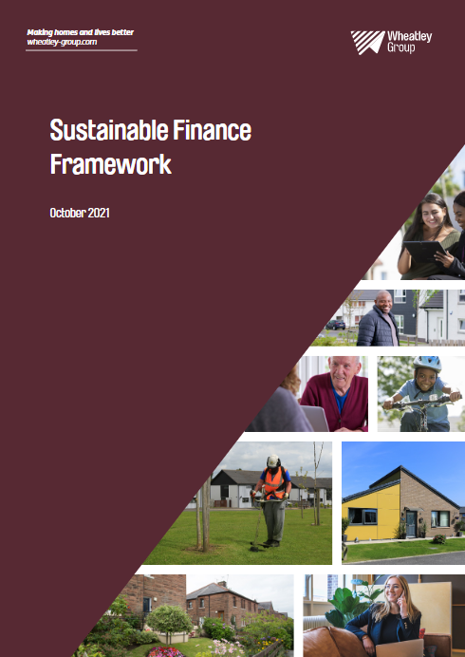
Sustainable finance framework
We have launched a Sustainable Finance Framework, accredited by S&P, under which we can issue sustainable or green or social public bonds in future (note, this does not impact existing funding); and
We have got sustainability financing in place from the European Investment Bank (a 2018 facility) which is directly linked to energy efficiency improvements on existing stock, the development of new, energy efficient homes and the provision of housing to refugee and asylum seekers (particularly from Syria).
Notes:
Wheatley’s new Sustainable Finance Framework (SFF) aligns the Group’s strategic sustainability priorities with its funding and financial strategy – allowing the Group to expand its funding base to help achieve its sustainability goals.
The move is in response to an increasing focus from funders on the Environmental, Social and Governance (ESG) impact of their investments and their support for low-carbon, environmentally friendly businesses.
Wheatley has developed the SFF with input from the NatWest Markets ESG advisory team, and external accreditation for the framework has been published by Standard and Poors in their Second Party Opinion.

Slide 14
Pathway to net zero advisory group
Inform Wheatley approach to net-zero
Thought leadership in Wheatley’s approach
Embedding sustainability, and measuring progress.
Champion Wheatley’s approach to sustainability
Identify opportunities for Wheatley to collaborate with others

Slide 15
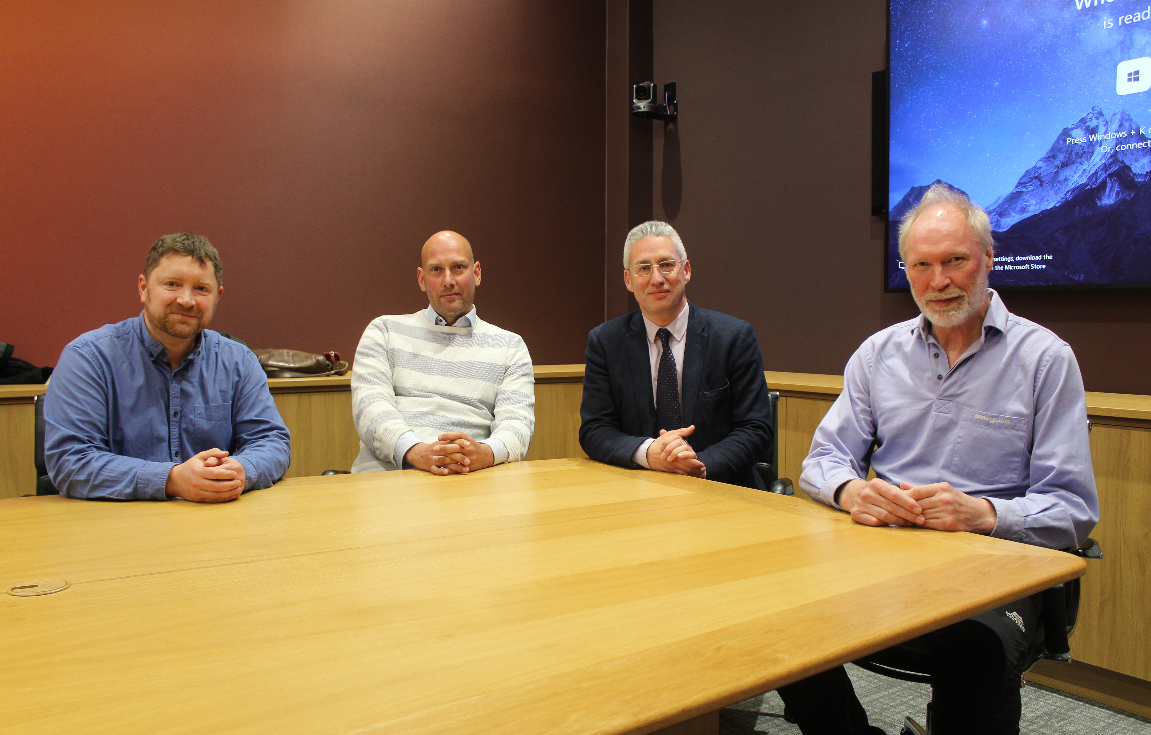
Pathway to net zero advisory group
Sean Smith - Professor of Future Construction and Director of Centre for Future Infrastructure, within the School of Engineering at the University of Edinburgh
Chris Morgan - Director of John Gilbert Architects in Glasgow and registered architect with over 25 years’ experience in ecological design and sustainable development.
John Currie - Director of the Scottish Energy Centre in the School of Engineering and Built Environment at Napier University and Chartered Engineer with over 35 years’ experience in teaching and practice.
York Ostermeyer - Director, ChillService, international perspective and expert in building measurement, data and information

