Slide 1
TPAS Scotland - conference
Tony Boyle

Slide 2
Why?

Slide 3
National Partners
Nation by nation approach – same partnerships

Slide 5
Why?
Collaborative working
Collecting & sharing best practices
UK-wide partnerships to influence and advocate for positive change – Public, Private, Third Sector
https://hswtaskforce.org.uk/

Slide 6
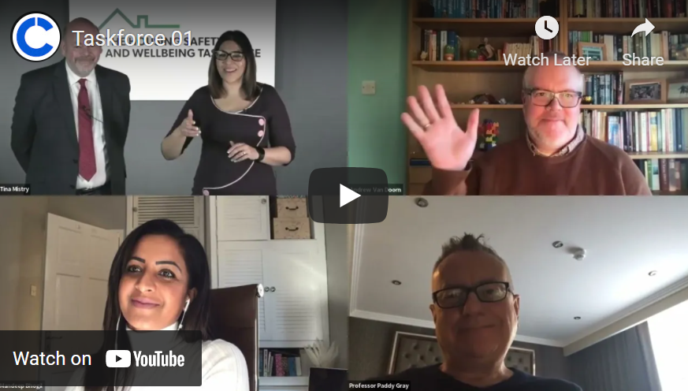
Launch
House of Commons
Virtual launch
50 attended
Dame Judith Hackitt
Key industry contacts
Lords
MP’s
Content
Taskforce
Ambassadors
Economic Assessment of Fire Safety (CEBR)
https://hswtaskforce.org.uk/news/

Slide 7
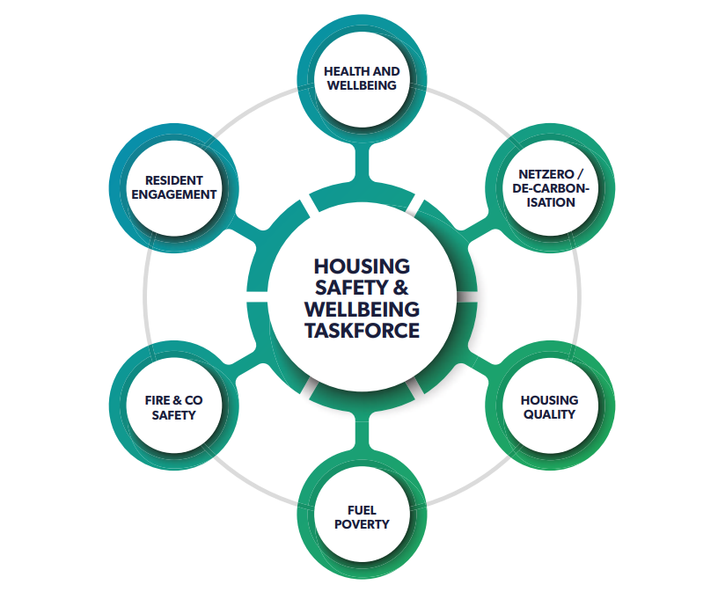
https://hswtaskforce.org.uk

Slide 8
Founding members

Slide 9
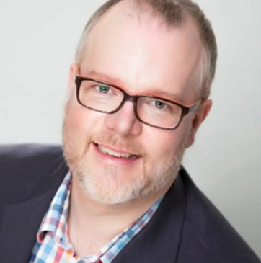
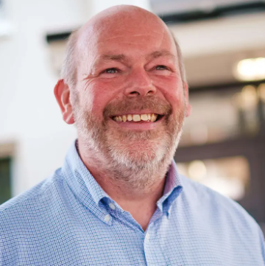
Ambassadors
Ambassador – Taskforce overall
Name - Mandeep Bhogil
Title – Director of Operations at Tower Hamlets Community Housing
Ambassador – Health & Wellbeing
Name - Andrew van Doorn
Job Title - Chief Executive of HACT
Ambassador – Resident Engagement
Name - Paul Dockerill
Job Title - Director of Energy & Programme Management at whg

Slide 10
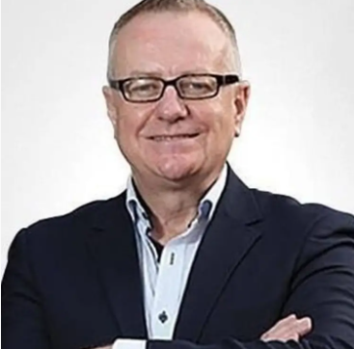
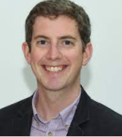
Ambassadors
Ambassador – Housing Quality
Name - Professor Paddy Gray
Job Title - Professor Emeritus of Housing, Ulster University
Ambassador – Fuel Poverty
Name - Matthew Copeland
Job Title - Policy Manager at NEA
Ambassador – NetZero/Decarbonisation
Name - Gerald Charles
Job Title - Contract Manager (Mechanical) at Merthyr
Valleys Homes, Retrofit Coordinator

Slide 11
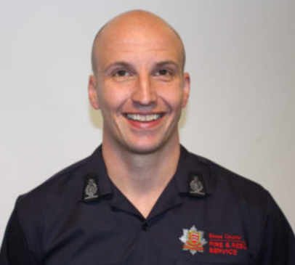
Ambassadors
Ambassador – Fire & CO
Name – Rick Hylton
Job Title – Chair, Home Safety Committee, NFCC
Ambassador – Taskforce overall, Behavioural insights
Name – Mark Gittos
Job Title - Owner at JMG Associates

Slide 12
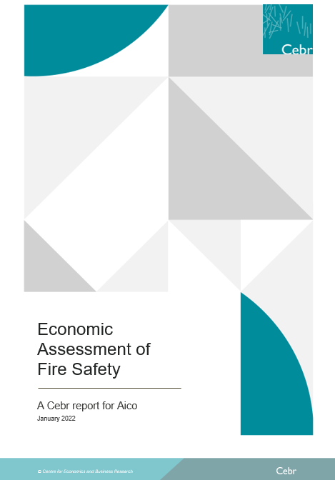
LD2 Harmonisation
Economic Assessment of Fire Safety - CEBR research
National Press launch – Key statistics
Human impact campaign – Stories from the community
Resident Engagement
Deprivation and Fire
Fire and ethnicity
#human impact – a political movement
Lobby – Homeowners
Home Office, Fire Safety & Rescue APPG

Slide 13
LD2 Harmonisation
Resident Engagement areas
Press and community launch
Deprivation and Fire, Fire and ethnicity – wards broken down
Birmingham City
Sandwell Council
Manchester City Council
London Borough of Barking & Dagenham
London Borough of Hackney
Knowsley Metropolitan Borough Council
Liverpool City Council
Blackpool Council
Burnley Borough Council
Blackburn with Darwen Borough Council

Slide 14
LD2 Harmonisation
Resident Engagement approach
LA leader and teams – GIS, Engagement, outreach
HA’s
F&RA
Public Health
Faith Forums
Community charities
Community groups
Places of worship
Schools
Local trauma charity

Slide 15
What does Safety & wellbeing mean to you?

Slide 16
UK wide platform – of all tenure 5yrs
Scotland tenants/residents – 1st to be part of it
Organically led by you

Slide 17
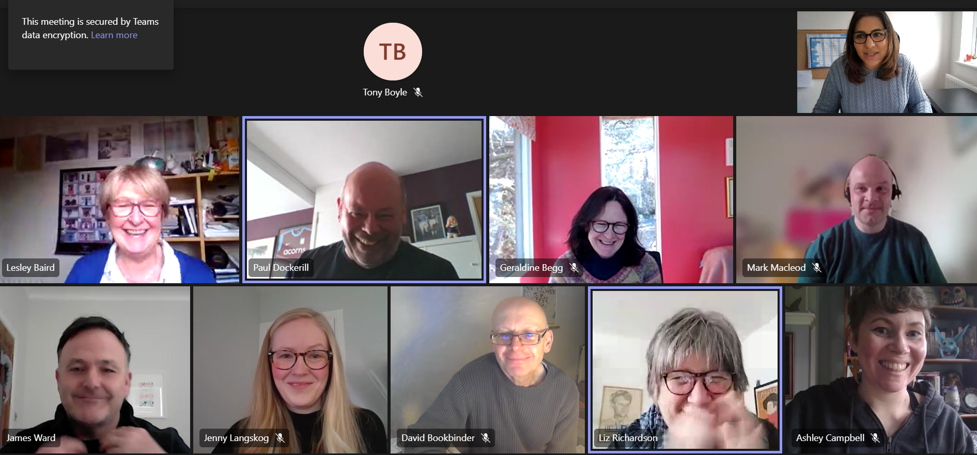
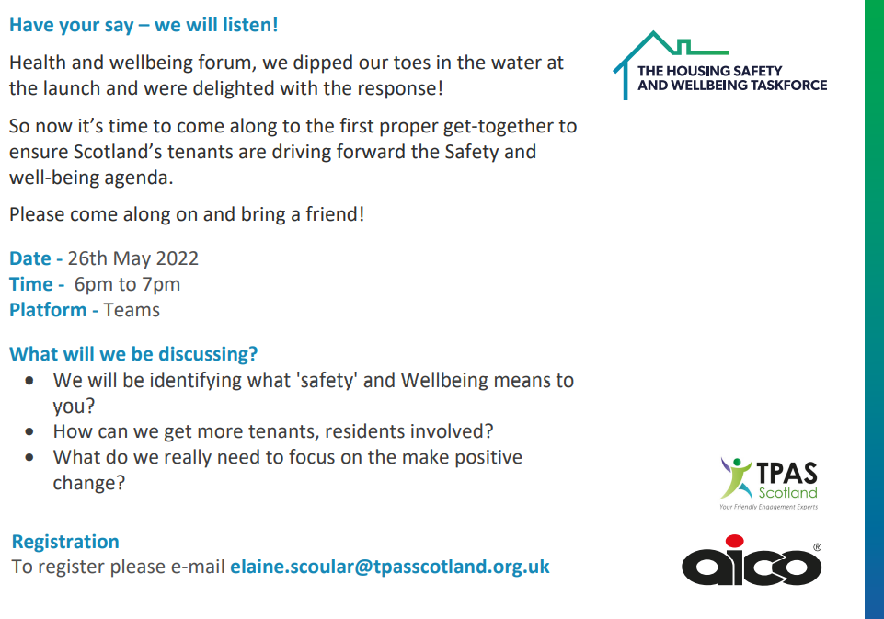
Sector roundtables – 2nd & 4th March 2022
Launch – 24th March 2022
1st meeting – 26th May 2022
2nd meeting – 21st June 2022, 6pm
Join in - elaine.scoular@tpasscotland.org.uk

Slide 18
Why?
How can the correct language be used?
Meaningful delivery?
How can we deliver? If we don’t know what this means to you.

Slide 19
TPAS Scotland - conference
Tony Boyle

